Slide 1
Configuration Management
Christopher Parnin

Slide 2
Learning Objectives
Describe issues related to configuration management (lack of having it).
Describe configuration management components, processes, and practices.
Explain why configuration management can address certain issues.
Analyze or devise a configuration management plan for a project.

Slide 3
Configuration Management (CM)
Pressman:
“is a set of tracking and control activities that are initiated when a software engineering projects begins and terminates when software is taken out of operation”
Configuration management originates from the 50s, when spacecraft failures resulted from undocumented changes.

Slide 4

Scenario
A customer wants a bug fix to software version 8.2.1, which was released 2 years ago. How to make sure can fix, build, and release?
Activity: Discuss other reasons why we may want configuration management?

Slide 5
Some other reasons
“works for me”; difficulty onboarding new devs, installing dependencies
Audits: Discovery request on changes made to system (e.g. no tracking in breathalyzer lawsuit)
Support product lines of software (basic, gold, diamond); different customer types.

Slide 6
Traditional SCM Process
Identify all items related to software.
Manage changes to those items.
Enable variations of items and changes.
Maintain quality of versions and releases.
Provide traceability between changes and requirements.

Slide 7
Traditional SCM Illustrated
Software Process
Software Configuration Items (SCIs)
Configuration Management
Code
Repository
Formal Change Requests
Task Tracking
Version
Configuration
Issue Tracking
Platform Configuration
Requirements
Audit Trails
Content
Baselines
Design

Slide 8
Traditional Definitions
A baseline is a snapshot of a set of configuration management items.
Any change to a baseline requires a change request. Change requests are approved by a change control authority.
Engineering change order is an approved change request with specified constraints and review criteria.

Slide 9
Modern Configuration Management
In traditional configuration management, the process is not fully triggered until deployment.
In modern configuration management, lightweight CM is integrated throughout the software process.

Slide 10
Components of Modern CM
git, branches
package managers
task and build managers
build machines, virtual environments (dev stacks)
software as a service
data migration

Slide 11
Source Control Management
Original system, SCCS by Rochman 1975*
Current tools:
tfs, svn, rcs, cvs, mercurial, mks, git
Distributed vs. Centralized
* http://basepath.com/aup/talks/SCCS-Slideshow.pdf

Slide 12
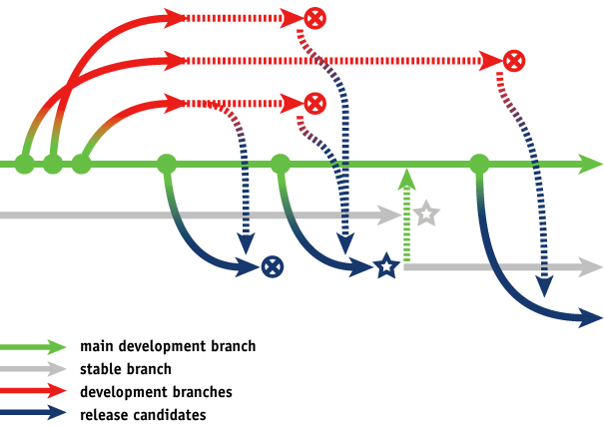
Branches
A branch is a mechanism for allowing concurrent changes to be made to a source repository.
Empirical evidence shows that branches can be effective, but devs can create ineffective branches*
* Assessing the Value of Branches with What-if Analysis - Bird 2012

Slide 13
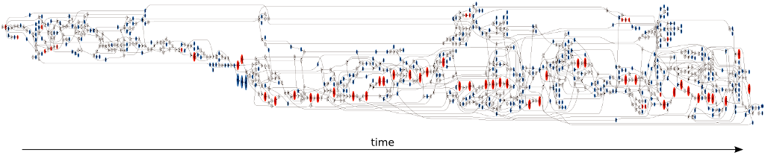
Branch Anti-Patterns: Appleton et al.
Merge Paranoia — avoiding merging at all cost, usually because of a fear of the consequences.
Merge Mania — spending too much time merging code instead of developing it.
Big Bang Merge — deferring branch merging and attempting to merge all branches simultaneously.
Never-Ending Merge — continuous merging activity because there is always more to merge.
Branch Mania — creating too many branches.
Cascading Branches — branching but never merging back to the main line.
Volatile Branches — branching with unstable files merged into other branches.
Development Freeze — stopping all development activities while branching and merging.
Integration Wall — using branches to divide the development team members, instead of dividing work.
Spaghetti Branching — integrating changes between unrelated branches.

Slide 14

Package Managers
Avoid problems related to platform configuration.
Binary: apt-get, choco (windows), brew (mac)
Source: bower (web), nuget (C#), pip (python), npm (node.js), maven (Java)*, RubyGems
* http://stackoverflow.com/questions/2710266/is-there-a-package-manager-for-java-like-easy-install-for-python

Slide 15
Exercise
Who has had trouble getting a project to build and run on their machine?
How long did it take, tricky experiences?

Slide 16
Example
* Run the installer before being able to build.

Slide 17
Task and Build Managers
Avoid problems related to build steps and dependencies.
Tools: make, ivy, ant, grunt
Tasks: Validation, testing, tool chains (antlr example), less to css translation, deployment, staging

Slide 18
Build Teams
Build teams take over the role of building software.
Can serve as gatekeepers on code integration.
Create build configuration and sometimes verification scripts
Putting out fires, helping with build failures
Understanding and Improving Software Build Teams - ICSE 2014

Slide 19
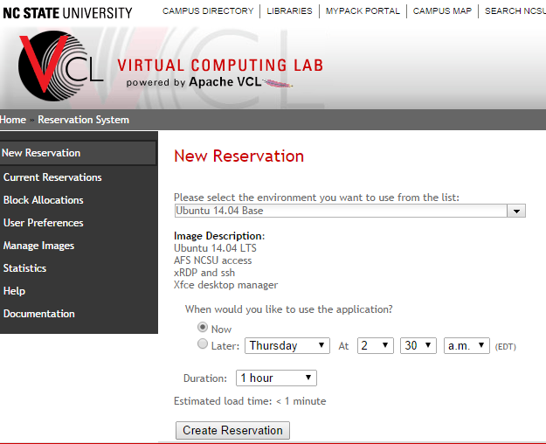
Dev and Production Environments
Configuration Tools
Virtual machines, VCL, EC2
Containers (Docker/Vagrant)
Full Specification: MirageOS (unikernels)

Slide 20
Configuration Tools
Ansible - “Playbook” scripts run over ssh
---
# The playbook creates a new database test and populates data in the database to test the sharding.
- hosts: $servername
user: root
tasks:
- name: Create a new database and user
mongodb_user: login_user=admin login_password=${mongo_admin_pass} login_port=${mongos_port} database=test user=admin password=${mongo_admin_pass} state=present
- name: Pause for the user to get created and replicated
pause: minutes=3
- name: Execute the collection creation script
command: /usr/bin/mongo localhost:${mongos_port}/test -u admin -p ${mongo_admin_pass} /tmp/testsharding.js
- name: Enable sharding on the database and collection
command: /usr/bin/mongo localhost:${mongos_port}/admin -u admin -p ${mongo_admin_pass} /tmp/enablesharding.js

Slide 21
Configuration Tools
Puppet - Less hands on, agents run on server.
puppet module install thias-mongodb
mongodb::key { '/etc/mongodb.key': content => 'c9otjehasAvlactocPiphAgC9', } class { '::mongodb': bind_ip => '0.0.0.0', auth => 'true', rest => 'true', replset => 'rs0', keyfile => '/etc/mongodb.key', verbose => 'true', }

Slide 22
Configuration Tools
Chef - “Cookbooks” ruby-based task and build recipes
knife cookbook site download mongodb
mongodb_user { testuser: username => 'testuser', ensure => present, password_hash => mongodb_password('testuser', 'p@ssw0rd'), database => testdb, roles => ['readWrite', 'dbAdmin'], tries => 10, require => Class['mongodb::server'], }

Slide 23
Containers
Vagrant
Docker
Will discuss more next lecture.

Slide 24
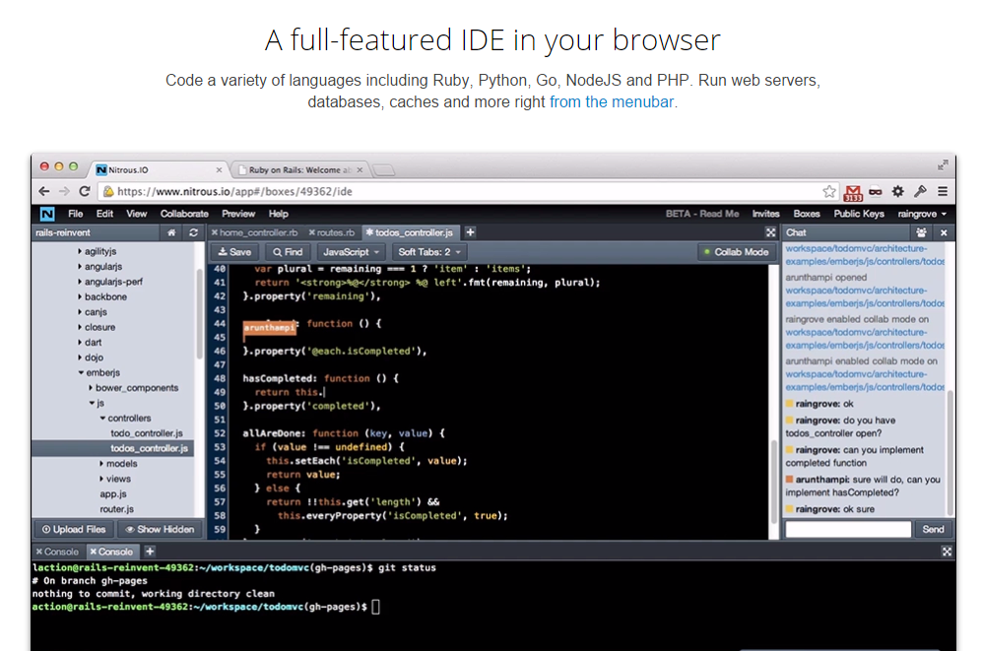
Software as a Service
Nitrous.io
“Create a X dev box in 60 seconds”
Where X is python, ruby,
node.js, etc

Slide 25
Data Migration
What happens to users running 5.1 and want to upgrade to 5.2?
Migration scripts: New tables, column changes, semantic changes
Always allow a linear transition between versions (Upgrade and downgrade).

Slide 26
Activity
Discuss with a partner some plans on using configuration management tools for your own projects.

